Slide 1

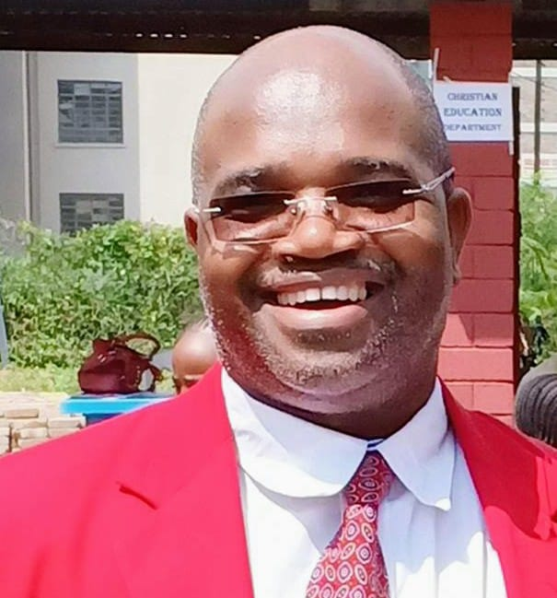

High acceptance and uptake of seasonal influenza vaccination among healthcare workers in Kenya following a pilot vaccination campaign, 2024
Head Shot
Dr. Linus Ndegwa
US CDC

Slide 2
Introduction
Recommendation that healthcare workers (HCWs) receive seasonal influenza vaccines (SIVs) annually by
  World Health Organization’s Strategic Advisory Group of Experts
  Kenya National Policy Guidelines on Immunization
  Kenya National Policy Guidelines on IPC
Kenya lacks an operational program to deliver SIVs to HCWs, resulting in limited access and low uptake
We assessed SIV uptake among HCWs in four selected counties in Kenya to understand acceptance and uptake to inform effective vaccination campaign strategies

Slide 3
Methods
Free SIVs were provided to HCWs in four Kenyan counties between November 2023 and February 2024
  Kakamega
  Nakuru
  Mombasa
  Siaya
SIV campaign included HCWs in both public and private facilities:
Tiered approach that involved sensitization and training of
  Health management leadership at national and subnational levels

Slide 4
Methods
Distribution of Information, education and communication materials
Trained vaccinators vaccinated HCWs over a period of 4 weeks in each county
Used pre-filled, single dose quadrivalent influenza vaccine (Vaxigrip)
Adverse events following immunization (AEFIs) were monitored post-vaccination
Pre- and post-vaccination surveys assessed acceptance factors
Data were analyzed using SAS 9.4.

Slide 5
Influenza vaccination coverage, 2023 - 2024
26,382 health workers vaccinated

Slide 6
Influenza vaccination coverage in Kakamega county – Dec 2023
6,262 health workers vaccinated

Slide 7
Influenza vaccination coverage in Nakuru county – Feb 2024
8,776 health workers vaccinated

Slide 8
Influenza vaccination coverage in Mombasa county – Feb 2024

Slide 9
Influenza vaccination coverage in Siaya county – Sep 2024

Slide 10
Influenza vaccination coverage wastage rate

Slide 11
Influenza vaccination coverage: AEFIs

Slide 12
Proportion of AEFIs reported

Slide 13
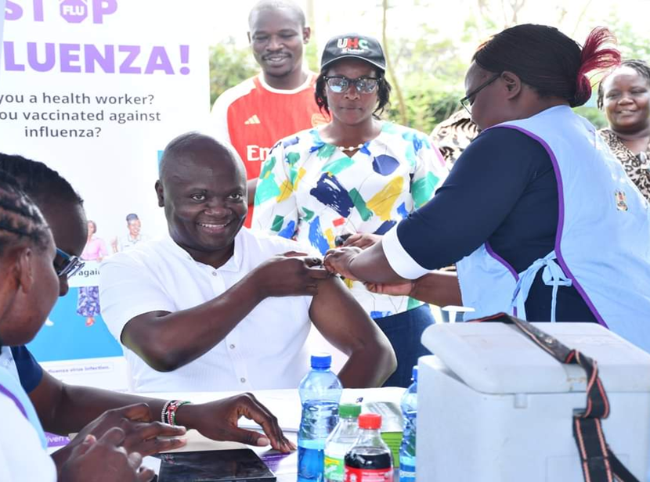
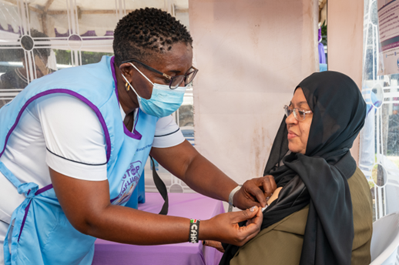
Best practices
A memo from the County Director of Medical Services/Public health office regarding the vaccination exercise encouraged vaccine uptake
County and sub county leaders, and health facilities in-charges were vaccinated first, leading by example
Vaccination teams followed a structured movement plan to guide their activities within the sub county
Health facility in charges
  Informed in advance on expected days of vaccination
  Mobilized staff in their health facilities

Slide 14
Best practices
CMEs were conducted
  level 4 and 5 health facilities to sensitize the HCWs about vaccination
  Cadre specific CMEs were held in some facilities
Support from the county and sub county HMTs in mobilizing HCWs for vaccination and conducting support supervision.
Vaccinators were HCWs that work within the respective sub counties and were familiar to their colleagues
In larger facilities, vaccinators moved between departments to maximize coverage

Slide 15
Challenges
Resistance to vaccination among some HCWs:
  County referral hospitals
  level 4 facilities
  Senior cadres (consultants, clinicians, older nurses)
Reasons included:
  Side effects
  Too many vaccines
  Short expiry dates
  Fear of the unknown
  Myths/misconceptions
  Vaccine was not mandatory
  Perception that exercise was rushed
  Perception that influenza is not a threat
  Belief that vaccine is undergoing clinical trials

Slide 16
Challenges
Inadequate fridge tags/thermometers for monitoring vaccine carrier temperatures during vaccination
  Encouraged to use foam pads and regular change of ice packs
Small vaccine carriers with limited capacity for influenza doses
Discrepancies between HCW numbers in micro plans and actual facility staff

Slide 17
Challenges
Lack of vaccination cards/certificates discouraged some HCWs from taking up the vaccine
Text message notification issues:
  Some messages did not go through due to promotional message blocks on HCWs’ phones
Logistical challenges in some sub counties due to
  long distances
  Difficult terrain
  Island-based facilities

Slide 18
Acknowledgement
The Task Force for Global
US CDC
WSU Global Health- Kenya
County Governments of Kakamega, Mombasa, Nakuru and Siaya
Ministry Of Health Kenya

Slide 19
Acknowledgement
The Task Force for Global
US CDC
WSU Global Health- Kenya
County Governments of Kakamega, Mombasa, Nakuru and Siaya
Ministry Of Health Kenya

